Slide 1
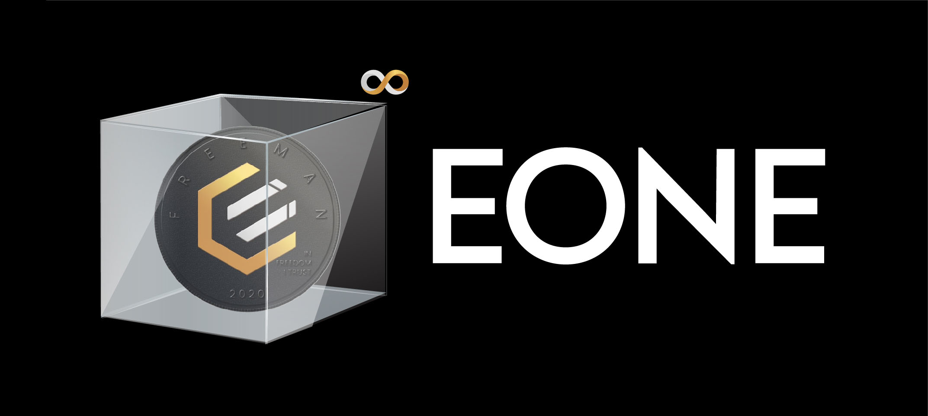
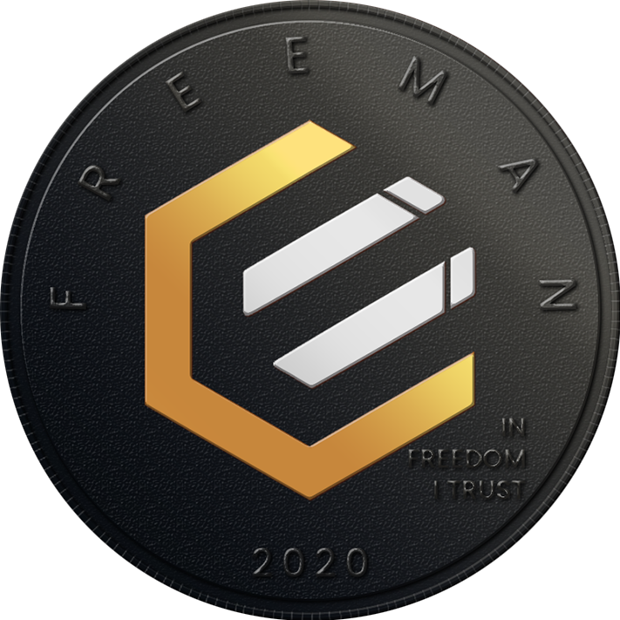
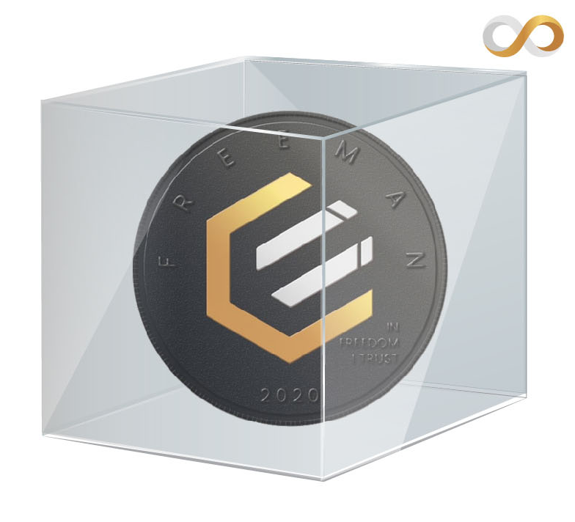







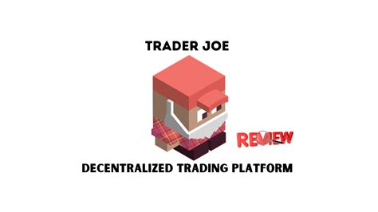

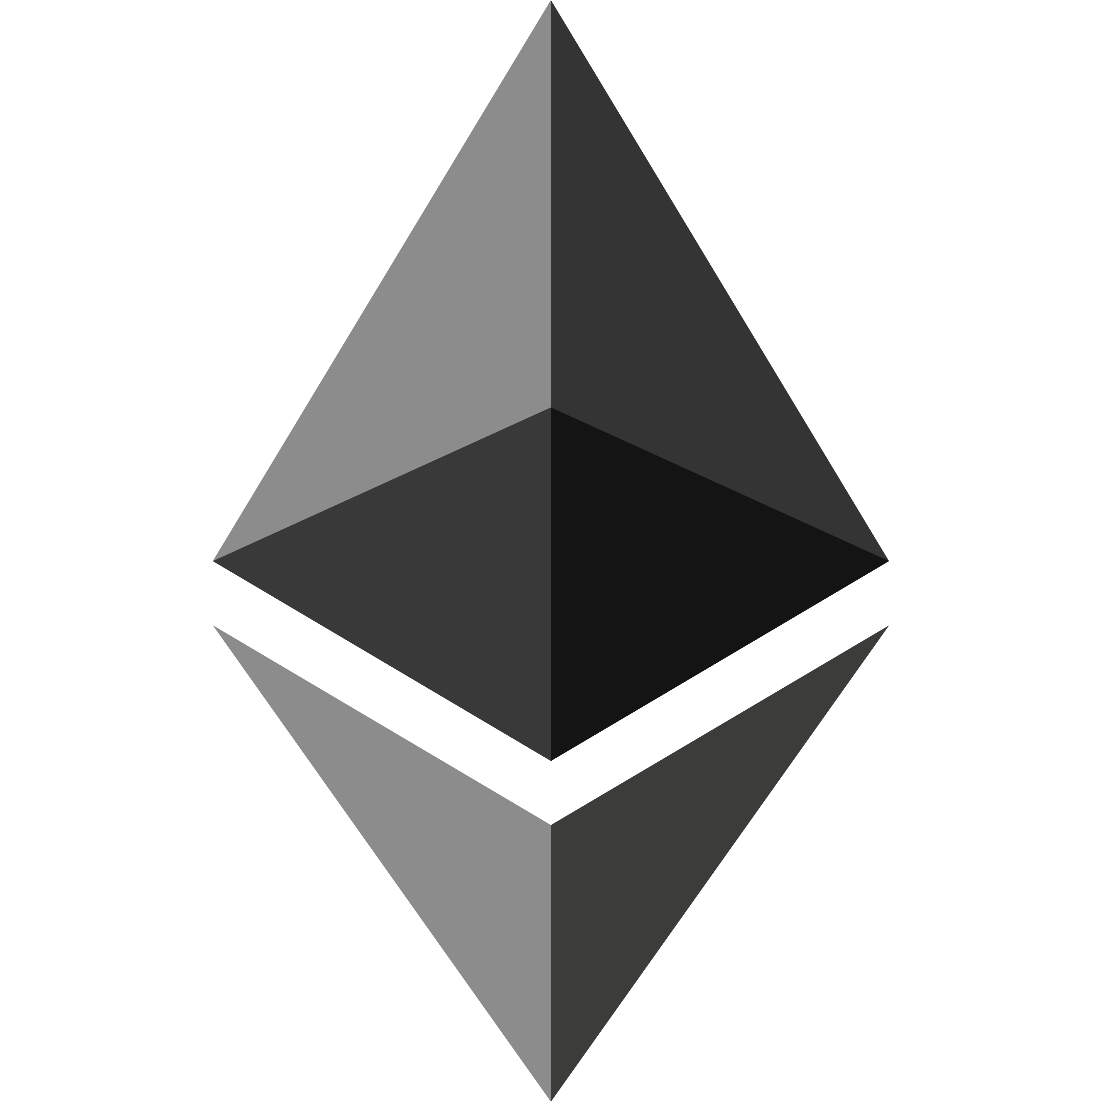





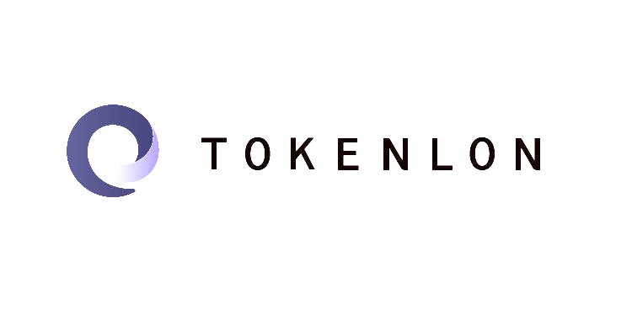
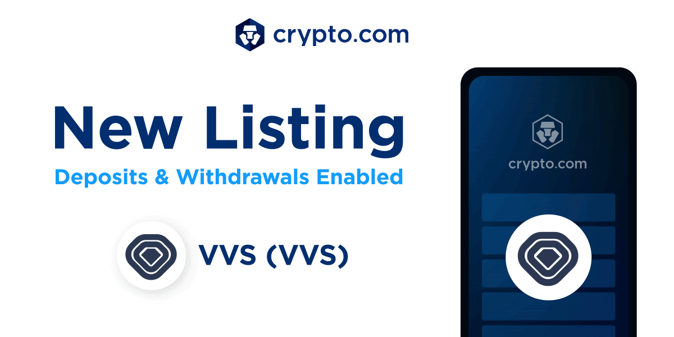
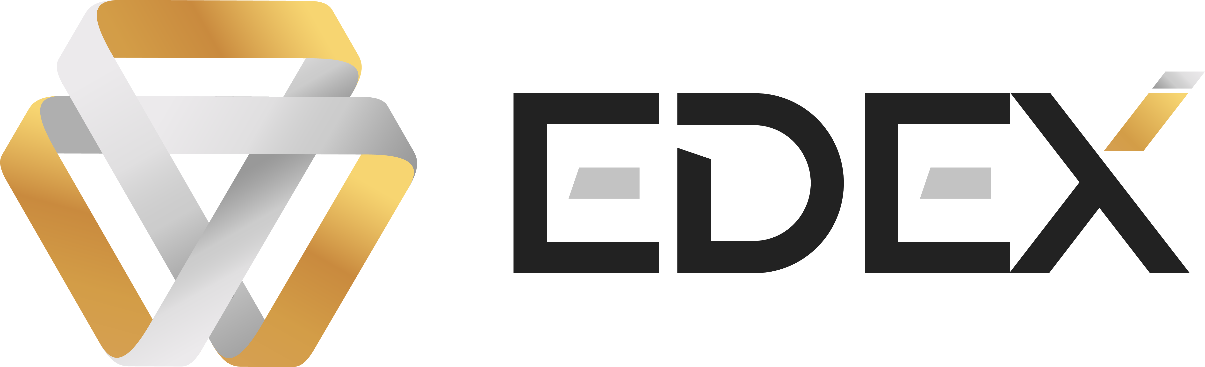







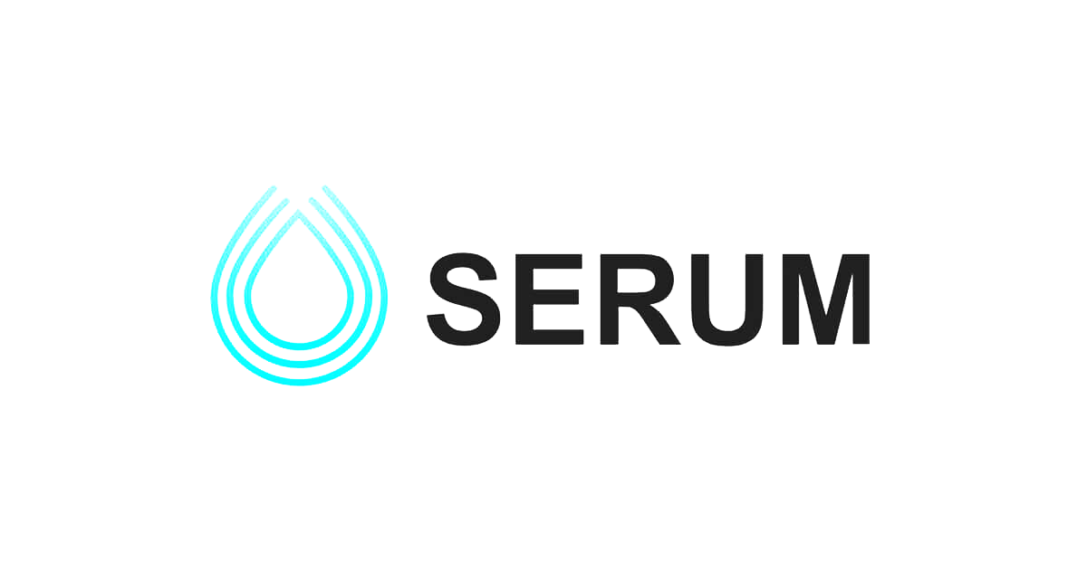




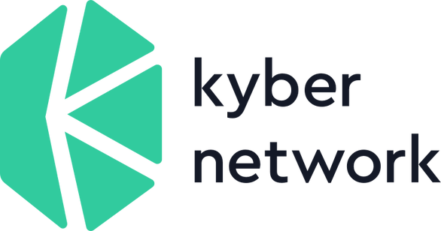

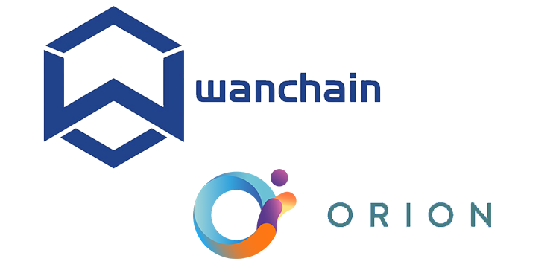



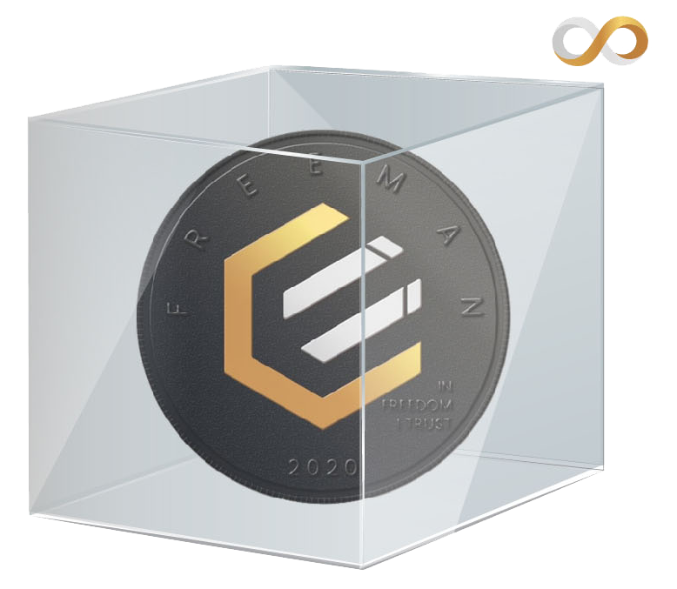
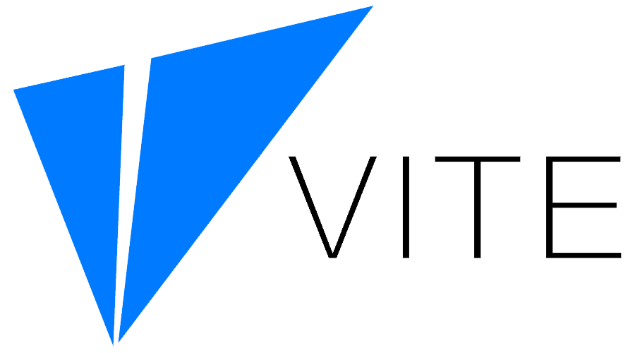


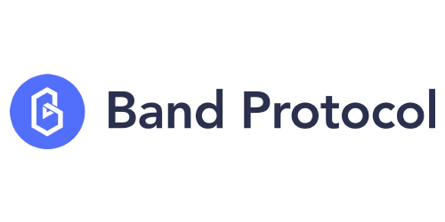
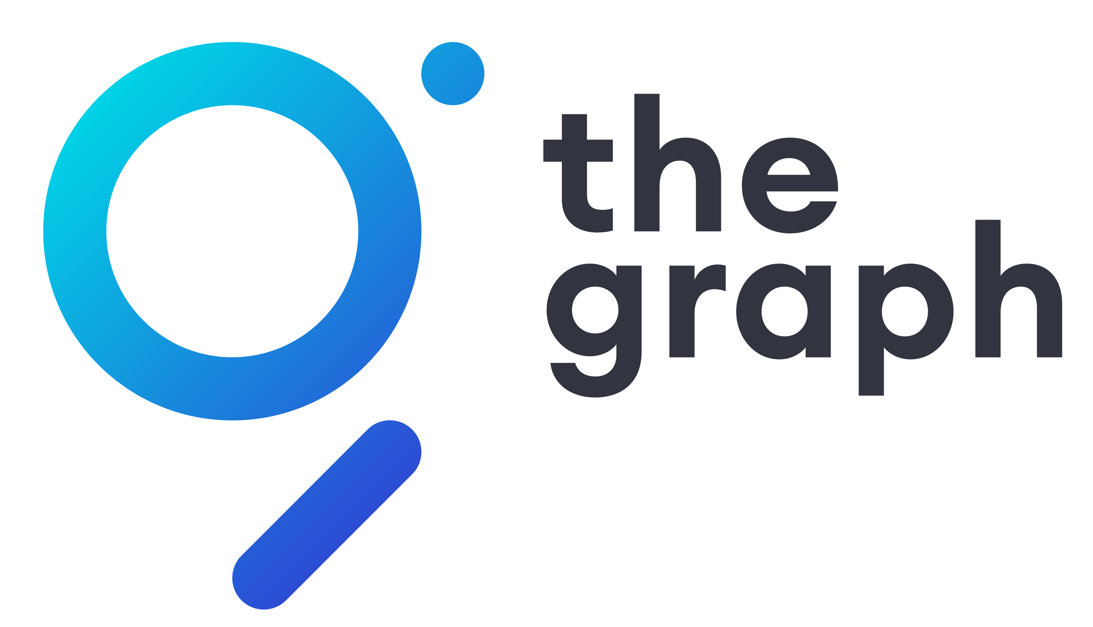
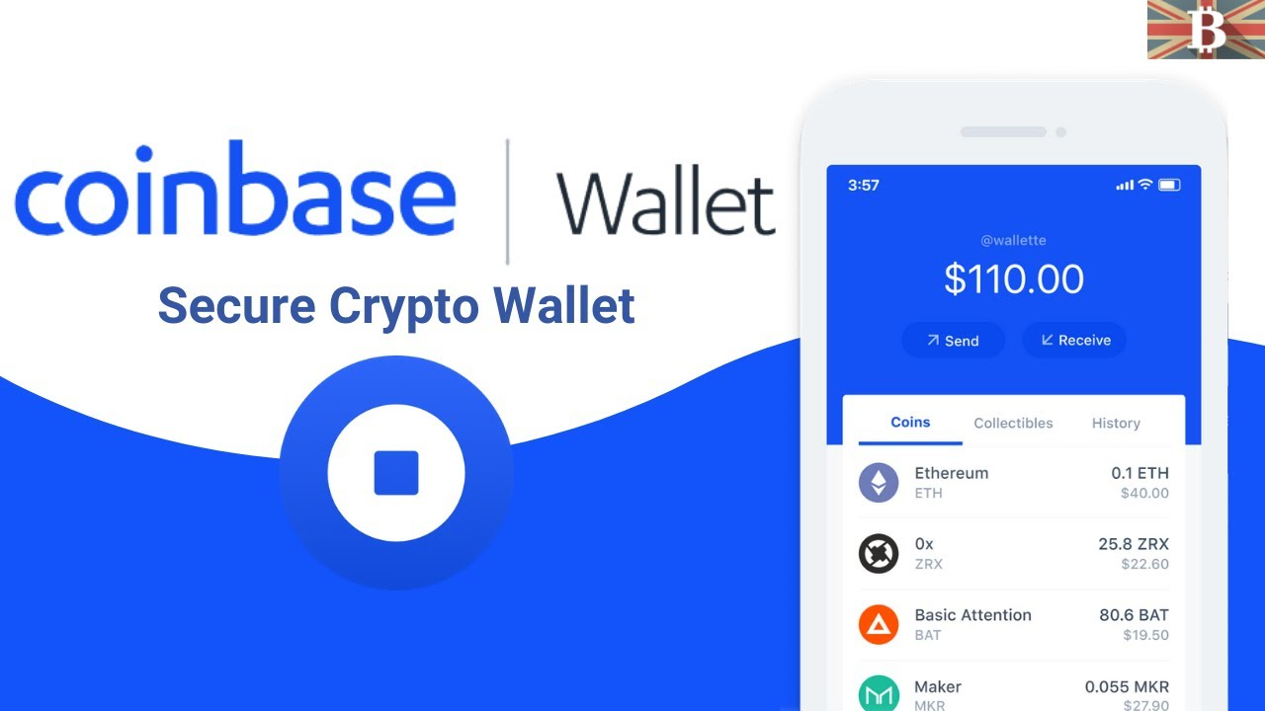
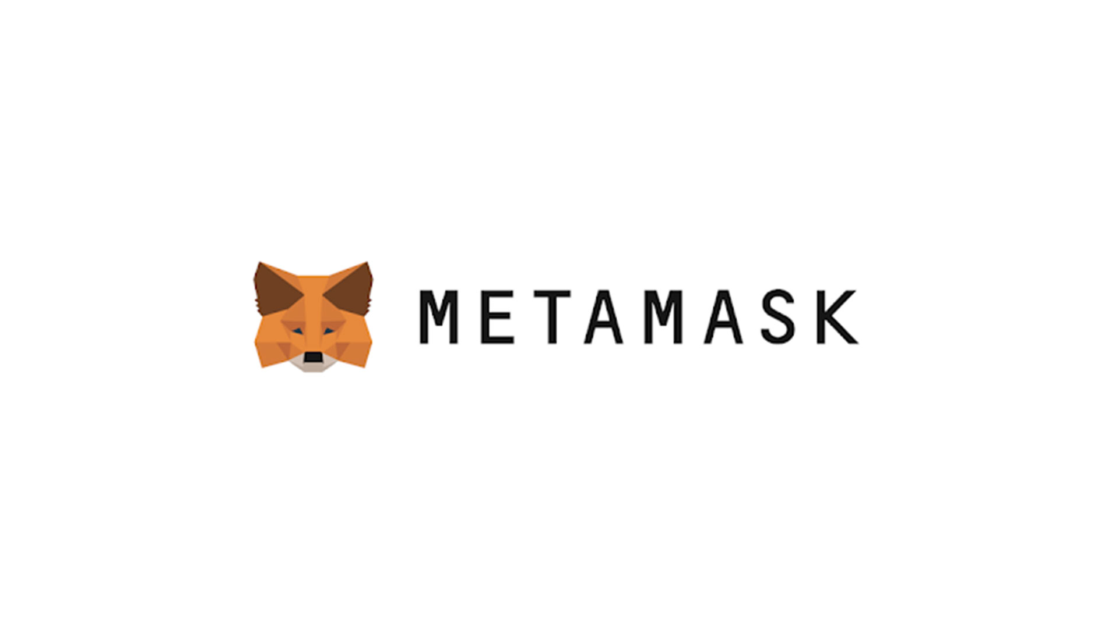
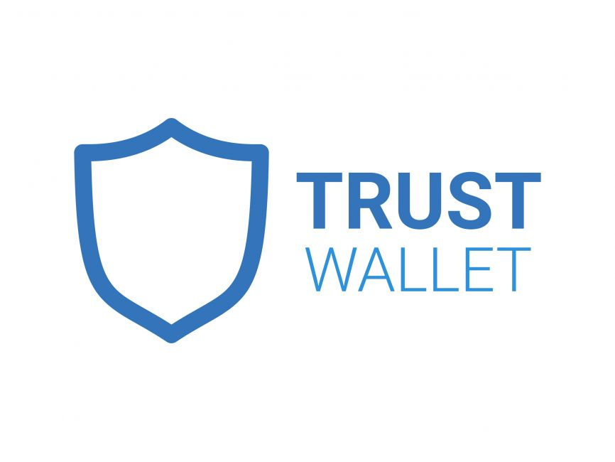
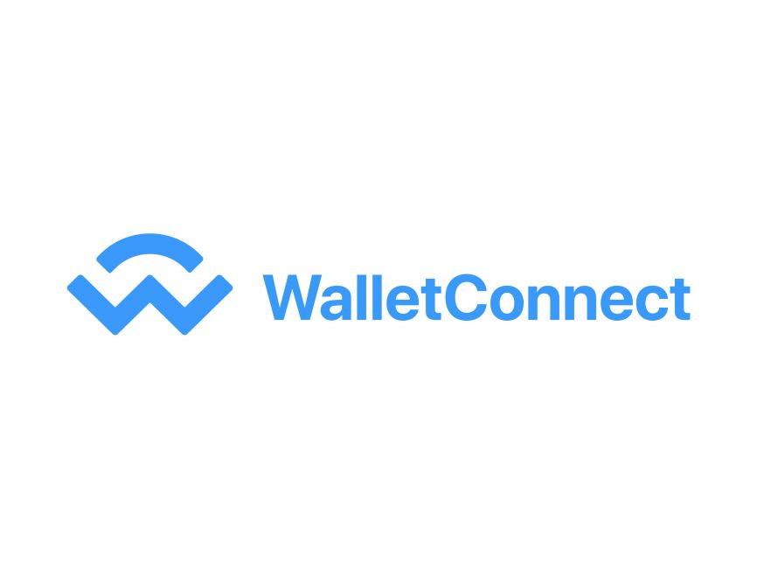
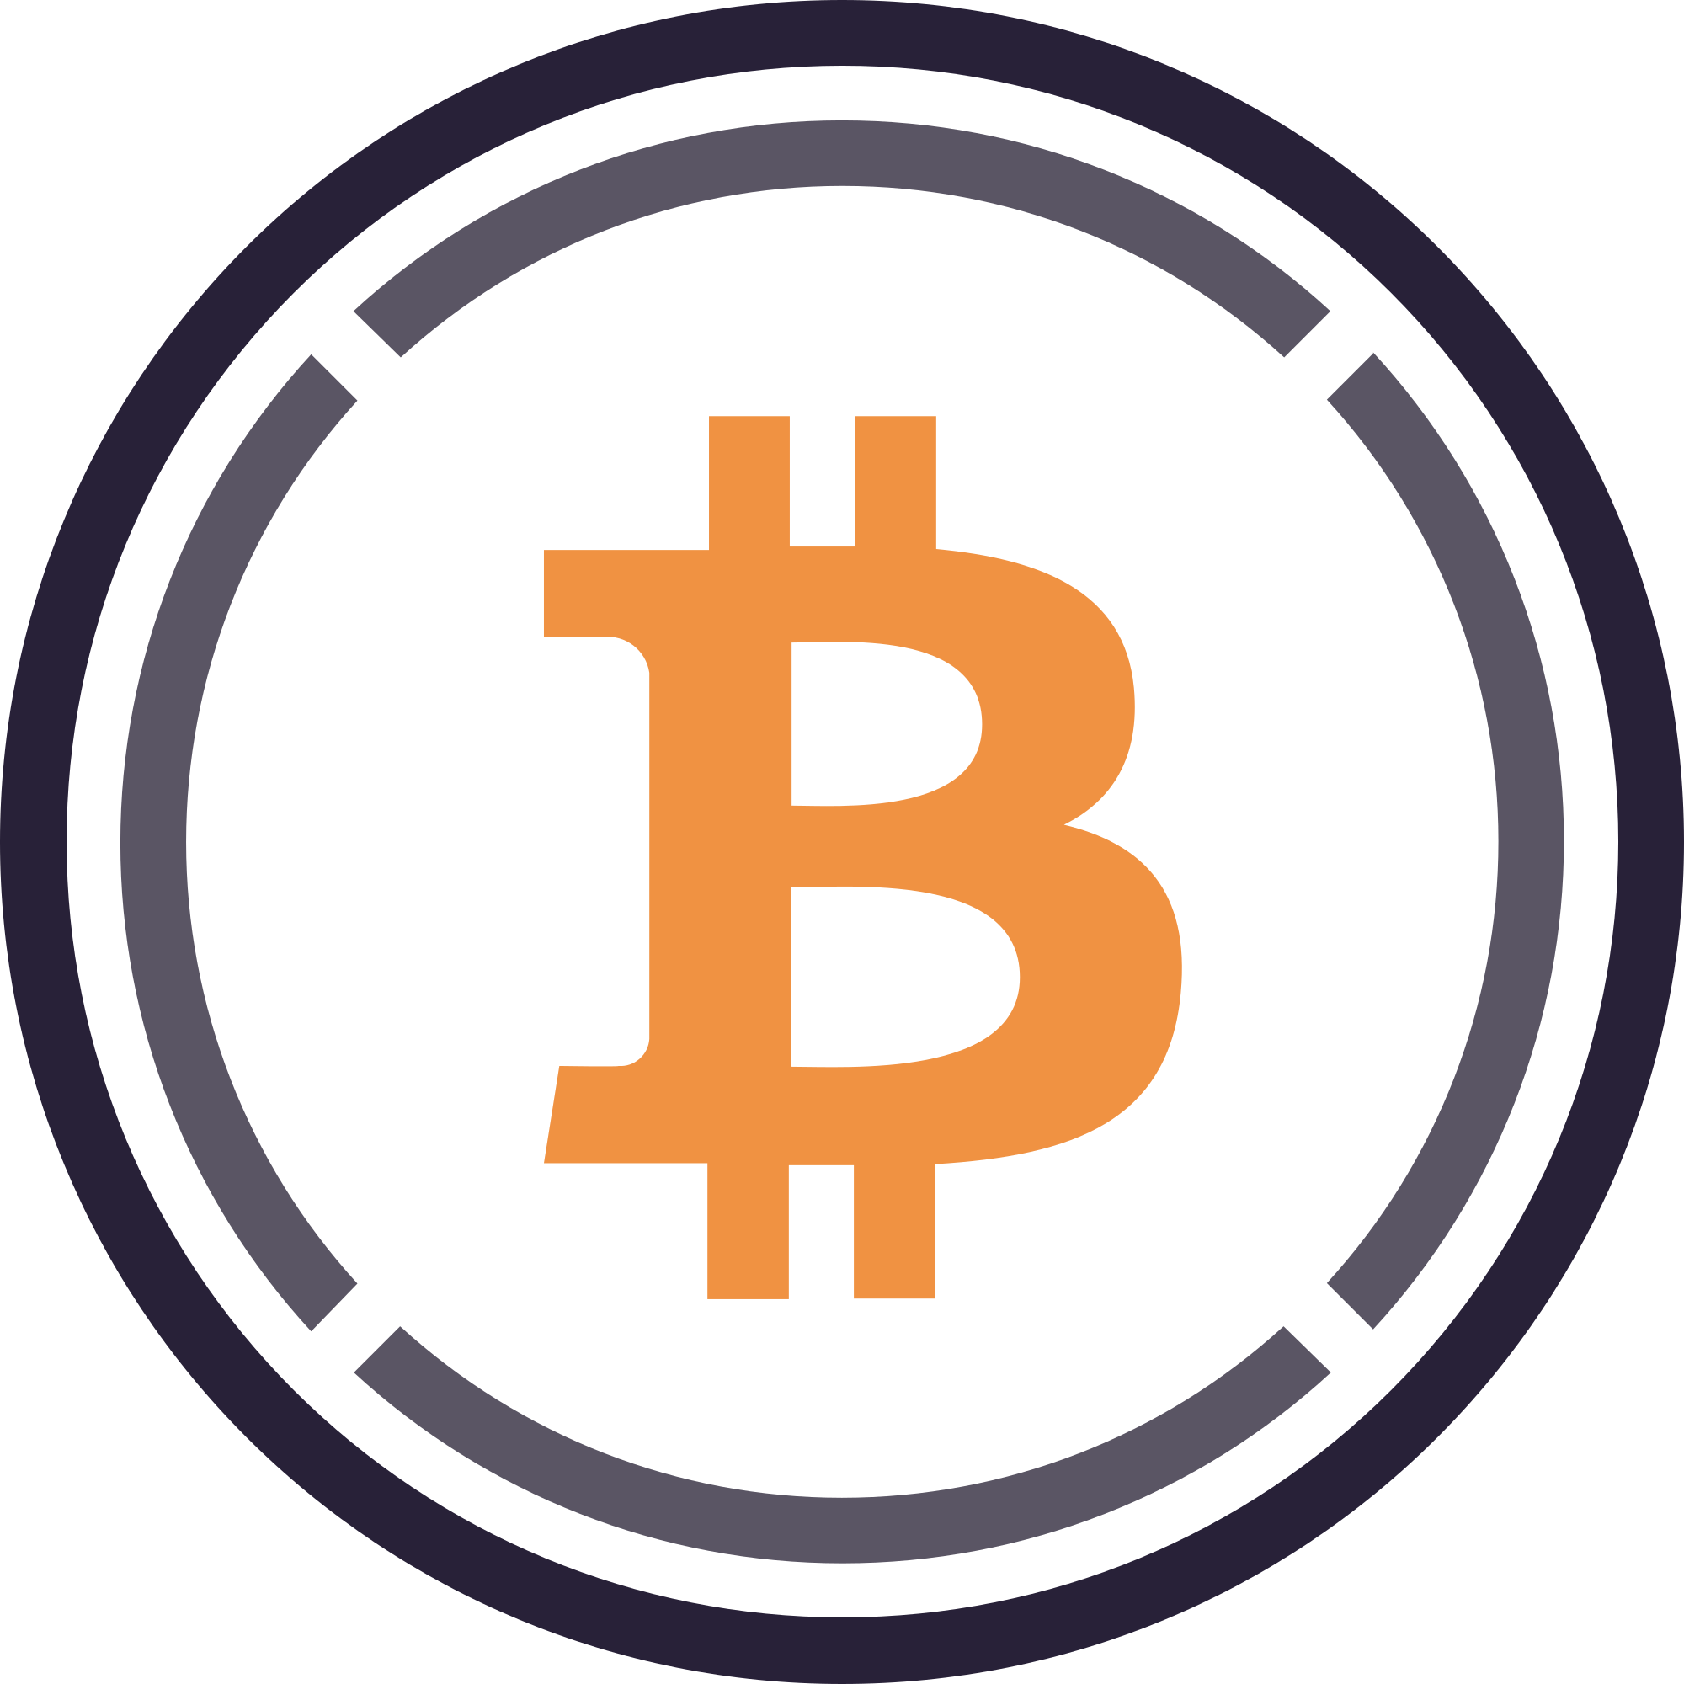

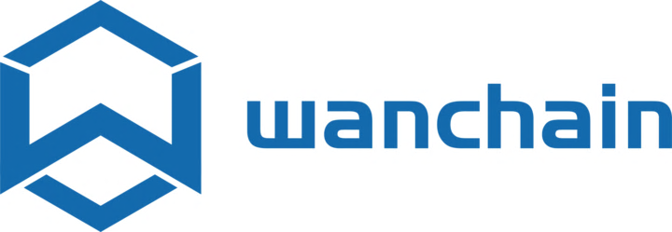
ERC20 TOKENIZED (WRAPPED) EPIC
WRAP
TRADE
Avalanche
Swap
Binance Smart Chain
Balancer
Ethereum
SpookySwap
Fantom
Order Book
BRIDGE
Moonriver
DEX
EXCHANGE
EDEX.network
Polkadot
Liquidity Aggregators
Wrap coins (No fee with staked ECR)
Wanchain
Tokemak
Olympus
UNWRAP
Each EPIC coin can be split into 100 million sub-units (0.00000001)
Fast, free* transactions
Enables powerful new cross-chain possibilities for dApp developers – Solidity language
INFRASTRUCTURE
Oracles
API3
Wallets
COMPARABLES:
WBTC
249k coins wrapped
$14bn market cap
$266m daily volume
179 exchanges
renBTC
40k coins wrapped
$1bn market cap
$7m daily volume
16 exchanges
WHY WRAP?
2 words – ‘More Utility’. Wrapped EPIC benefits by being able to use all the existing, unstoppable, fast and secure DEX infrastructure available today.
Centralized platforms are burdened with many compliance obligations due to regulatory requirements. As a result, their internal policies often prohibit confidential assets. (e.g. Coinbase, Crypto.com, Kraken UK) EONE solves this.
Powered by:
Secure Multi-Party Computation
EONE Explainer v04 | Dec 21

